Slide 1
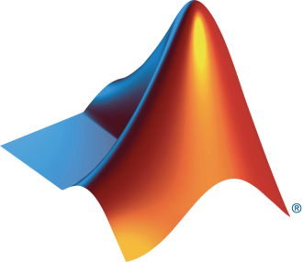

HPRC and MathWorks Present: Reinforcement Learning Onramp

Slide 2
Today:
6:15 pm – 6.30 pm: Set-up
Intro to Machine Learning
Create MathWorks account
Log in to Machine Learning Onramp / Test MATLAB Online
6.30 pm – 8.00 pm: Machine Learning Onramp (on your own)

Slide 3
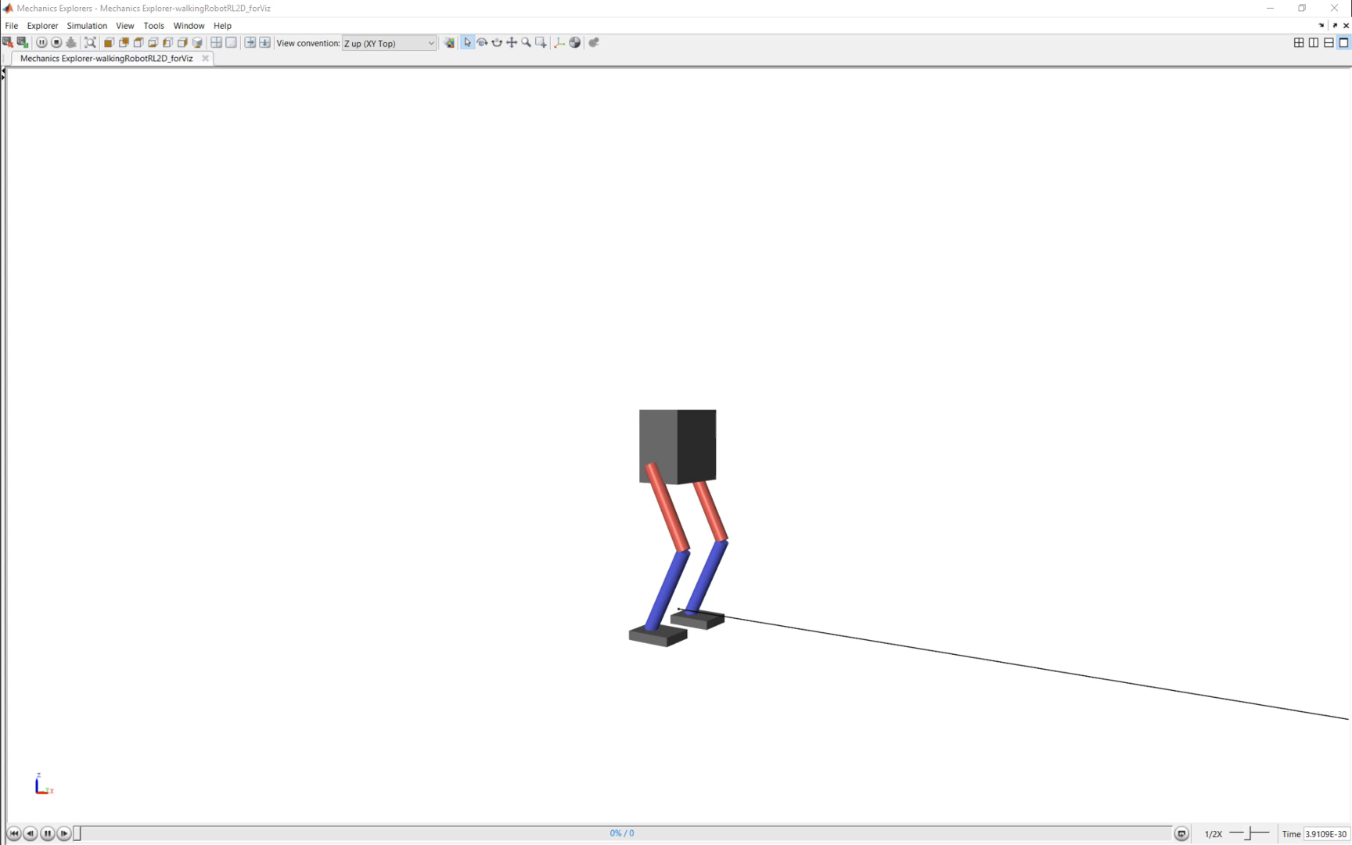

What is Reinforcement Learning?
What is Reinforcement Learning?
Type of machine learning that trains an ‘agent’ through repeated interactions with an environment
How does it work?
Through a trial & error process that uses a reward system to maximize success
Notes:
Let’s look at RL directly with an example.
Here, we have a robot, that is trying to learn how to walk straight.
At first, it simply falls over.
But as it continues to try over and over again, it starts to improve until finally it can walk in a straight line.
So through repeated interactions with an environment, an agent (in this case, the robot) has learned how to walk straight.
And it did this through a trial and error process that uses a reward signal to maximize success.

Slide 4
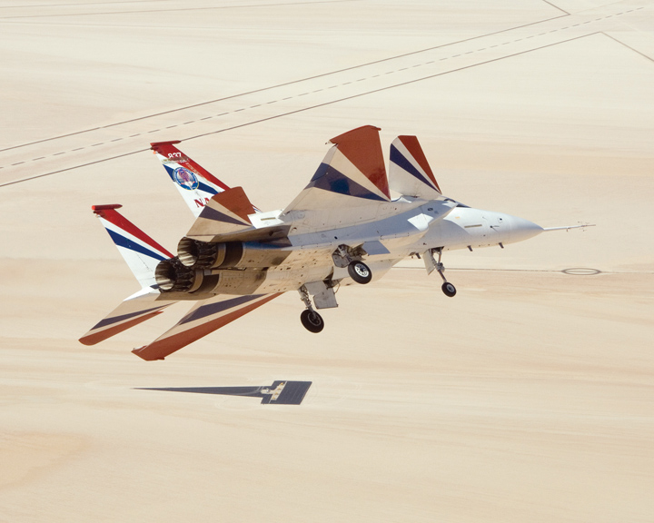
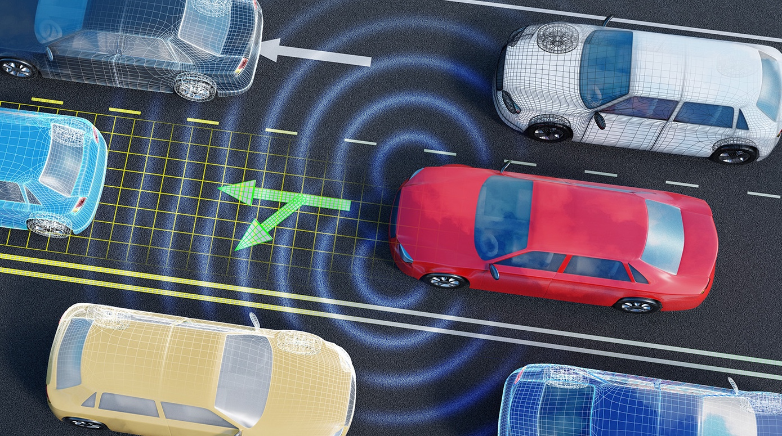
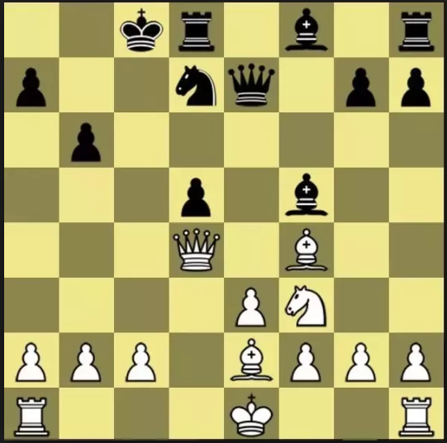
Reinforcement Learning enables the use of Deep Learning for Controls and Decision Making Applications
Robotics
Autonomous driving
Controls
A.I. Gameplay
Notes:
Reinforcement learning has many applications Including controls, autonomous driving, video game playing and robotics.

Slide 5
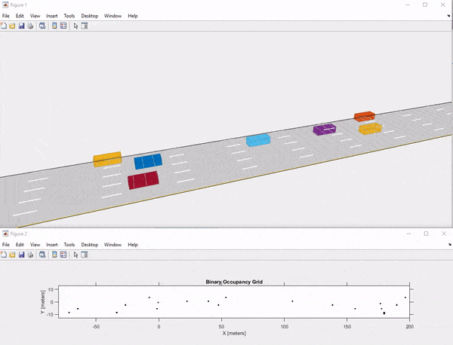
How Does Reinforcement Learning Work?
STATE
AGENT
ACTION
REWARD
ENVIRONMENT
Notes:
Let’s take a look at how RL works using an autonomous vehicle example. Here, we see the dark blue car driving down a five-lane highway while avoiding other cars.
Teaching a car to do this through a trial and error process comes uses the following diagram. We see five components here – an agent, action, environment, reward, and state. Let’s talk about what these are.

Slide 6
A Practical Example of Reinforcement Learning Training a Self-Driving Car
STATE
AGENT
ACTION
Vehicle’s computer learns how to drive… (agent)
using sensor readings from LIDAR, cameras,… (state)
that represent road conditions, vehicle position,… (environment)
by generating steering, braking, throttle commands,… (action)
to avoid collisions and lane deviation… (reward).
REWARD
ENVIRONMENT
The goal of Reinforcement learning is for the agent to find an optimal algorithm for performing a task
Notes:
Starting with the agent. In this case, our car’s computer that is learning to drive.
It is using sensor readings from lidar, radar and other cameras, which make up the state.
These sensor readings represent the road conditions, our vehicle’s position, and other vehicles on the road (environment)
Based on the state, we take an action like steering, braking, and turning.
And if we avoid collisions, maximize fuel efficiency and optimize driver comfort, we receive a reward.
The goal of RL is to find an optimal algorithm for performing a task and it does this through trial-and-error runs.

Slide 7


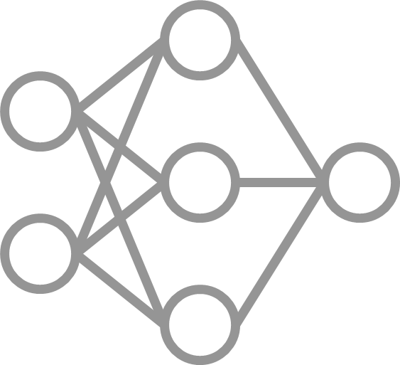




Reinforcement Learning Workflow
Environment
Reward
Policy
Agent
Training
Deploy

Slide 8
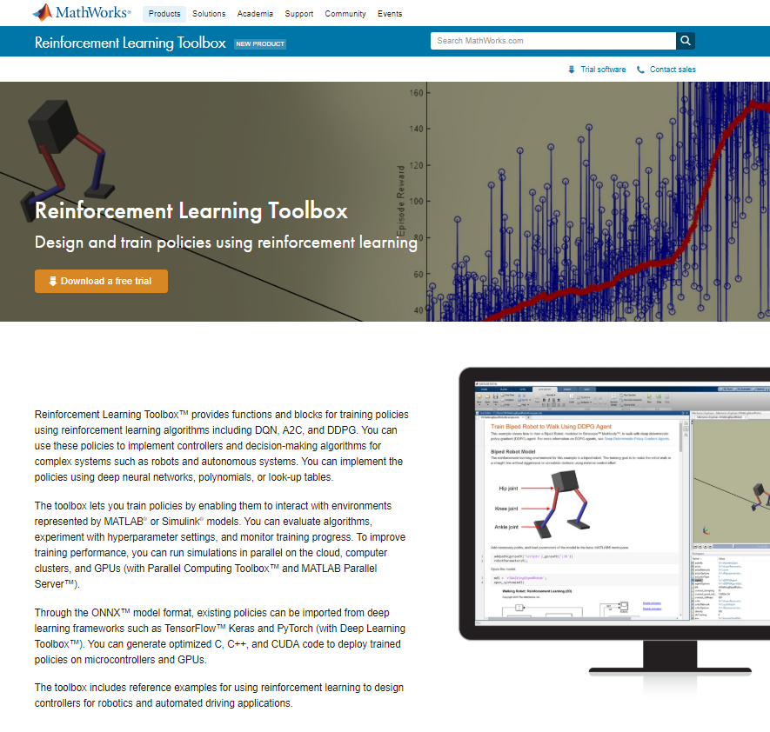
Reinforcement Learning Toolbox
Built-in and custom reinforcement learning algorithms
Environment modeling in MATLAB and Simulink
Existing scripts and models can be reused
Deep Learning Toolbox support for representing policies
Training acceleration with Parallel Computing Toolbox and MATLAB Parallel Server
Deployment of trained policies with GPU Coder and MATLAB Coder
Reference examples for getting started

Slide 9
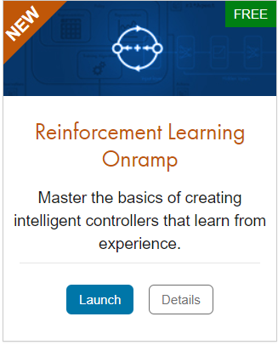
TO DO
Go to https://matlabacademy.mathworks.com/
Log in to your MathWorks account
Launch Reinforcement Learning Onramp

Slide 10
Prizes
Complete at least 50% of the Reinforcement Learning Onramp to be eligible for any prize
Bring your laptop when you come to collect the prize
Follow Us on Facebook!
Find us on Facebook at [Insert Facebook Group Name]

